Slide 1
304 - Machine Learning and Deep Learning Models
Project Title-
Predictive Accuracy of Probability of Default of Credit Card Clients
Guided By -
Ms. Tanushree Bhattacharjee
Presented By -
Mr. Amith Mohan, Mr. Vipul Anand & Mr. Ashutosh Kumar

Slide 2
Data Source & Information :
This research aimed at the case of customers default payments in Taiwan and compares the predictive accuracy of probability of default among five machine learning methods (Logistic Regression, Decision Tree, Random Forest, K-NN & Naive Bayes)
From the perspective of risk management, the result of predictive accuracy of the estimated probability of default will be more valuable than the binary result of classification - credible or not credible clients.
This dataset contains information on default payments, demographic factors, credit data, history of payment, and bill statements of credit card clients in Taiwan from April 2005 to September 2005.
Source of Data - https://archive.ics.uci.edu/ml/datasets/default+of+credit+card+clients

Slide 3
Attribute Information:
There are 25 variables:
ID:ID of each client
LIMIT_BAL: Amount of given credit in NT dollars (includes individual and family/supplementary credit
SEX: Gender (1=male, 2=female)
EDUCATION: (1=graduate school, 2=university, 3=high school, 4=others, 5=unknown, 6=unknown)
MARRIAGE: Marital status (1=married, 2=single, 3=others)
AGE: Age in years
PAY_0: Repayment status in September, 2005 (-1=pay duly, 1=payment delay for one month, 2=payment delay for two months, … 8=payment delay for eight months, 9=payment delay for nine months and above)
PAY_2: Repayment status in August, 2005 (scale same as above)
PAY_3: Repayment status in July, 2005 (scale same as above)
PAY_4: Repayment status in June, 2005 (scale same as above)
PAY_5: Repayment status in May, 2005 (scale same as above)
PAY_6: Repayment status in April, 2005 (scale same as above)

Slide 4
Attribute Information Continue…
BILL_AMT1: Amount of bill statement in September, 2005 (NT dollar)
BILL_AMT2: Amount of bill statement in August, 2005 (NT dollar)
BILL_AMT3: Amount of bill statement in July, 2005 (NT dollar)
BILL_AMT4: Amount of bill statement in June, 2005 (NT dollar)
BILL_AMT5: Amount of bill statement in May, 2005 (NT dollar)
BILL_AMT6: Amount of bill statement in April, 2005 (NT dollar)
PAY_AMT1: Amount of previous payment in September, 2005 (NT dollar)
PAY_AMT2: Amount of previous payment in August, 2005 (NT dollar)
PAY_AMT3: Amount of previous payment in July, 2005 (NT dollar)
PAY_AMT4: Amount of previous payment in June, 2005 (NT dollar)
PAY_AMT5: Amount of previous payment in May, 2005 (NT dollar)
PAY_AMT6: Amount of previous payment in April, 2005 (NT dollar)
default.payment.next.month: Default payment (1=yes, 0=no)

Slide 5
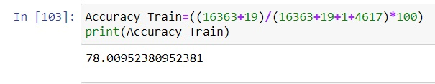
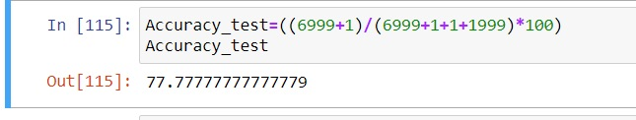
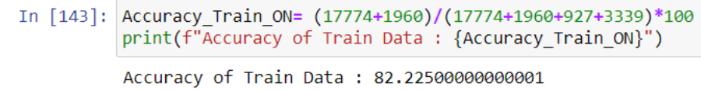

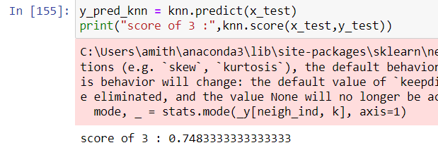
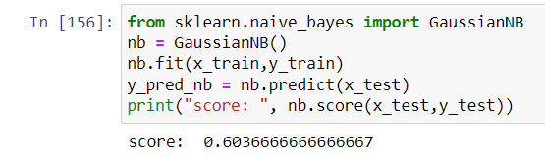

Result:
Logistics Regression Train Data
Logistics Regression Test Data
Decision Tree Train Accuracy
Decision Tree Test Accuracy
K-NN
Naive Bayes
Random Forest

Slide 6
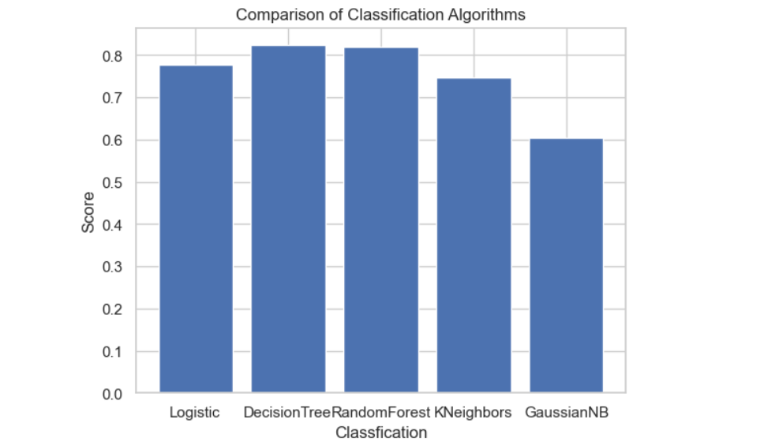
Conclusion Graph:

